Slide 1
HYDRAULICS & HYDRAULIC MACHINES

Slide 2
Unit 6: KAPLAN TURBINE

Slide 3
Learning Outcome
In this unit, you will learn
Components of Kaplan turbine
Velocity triangles for Kaplan turbine
Workingprinciple of Kaplan turbine
Draft tube: Types & efficiency

Slide 4
Reaction Turbines
Reaction turbines are those turbines which operate under hydraulic pressure energy and part of kinetic energy
Examples: Francis turbines, Kaplan turbine

Slide 5
Types of reaction turbines
1. Radially outward flow reaction turbine
2. Radially inward flow reaction turbine

Slide 6
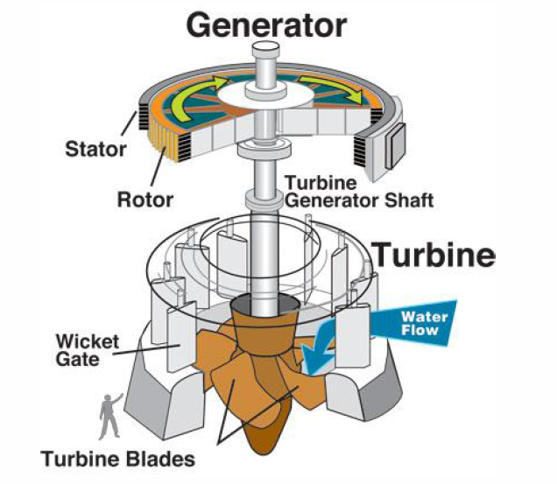
Schematic of Kaplan turbine

Slide 7
Components of Reaction turbines
The main component parts of a reaction turbine are:
(1) Casing
(2) Guide vanes
(3) Runner with vanes
(4) Draft tube

Slide 8
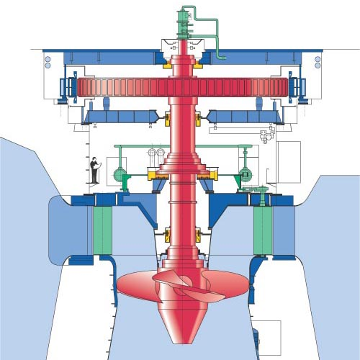
Kaplan Turbine
.

Slide 9
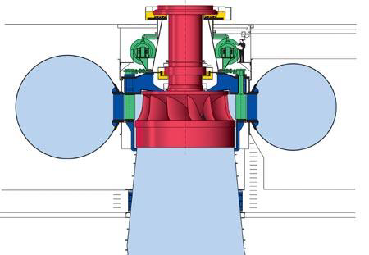
Components of Kaplan Turbine
Shaft
Runn
Volute
Volute
Moving
Guide vanes
Draft Tube

Slide 10
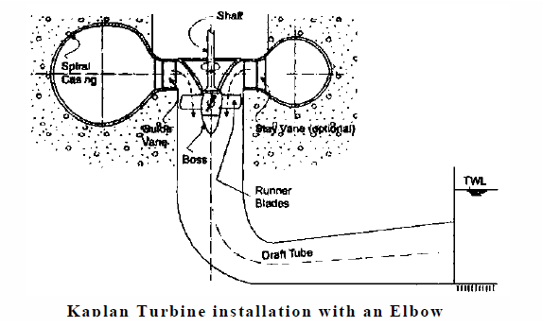
Kaplan Turbine installation with an Elbow

Slide 11
Velocity triangles of Kaplan turbine

Slide 12
Working principle of Kaplan turbine
V_{f}

Slide 13
Draft tube
Draft tube is a divergent tube one end of which is connected to the outlet of the turbine and other end is immersed well below the tailrace (Water level).
The major function of the draft tube is to increase the pressure
from the inlet to outlet of the draft tube as it flows through it
and hence increase it more than atmospheric pressure.
The other function is to safely discharge the water that has worked on the turbine to tailrace.

Slide 14
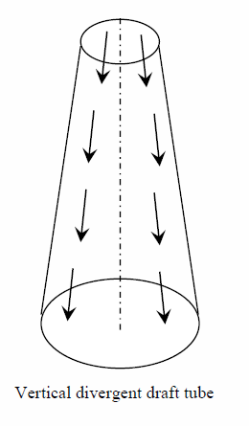
Types of draft tubes
Vertical divergent draft tube
The draft tube has the shape of a frustum of
a cone.
Generally provided for low specific speed
cone angle is not to exceed 8 degree

Slide 15
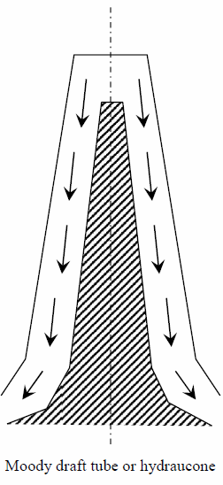
Types of draft tubes contd....
Moody draft tube or hydraucone
This is a bell mouthed draft tube or a
conical tube with a solid conical central core

Slide 16
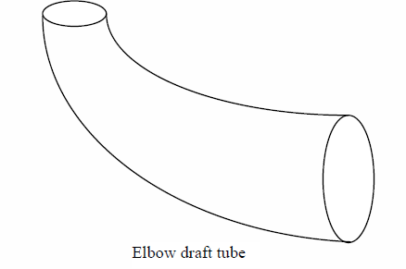
Types of draft tubes contd....
Elbow draft tube
This draft tube affords to discharge the water
horizontally to the tail race.

Slide 17
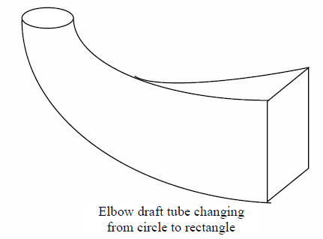
Types of draft tubes contd....
Elbow draft tube changing
from circle to rectangle
This is a further improvement
of the simple elbow draft tube

Slide 18
Problems
1.A Kaplan turbine develops 9000 kW under a net head of 7.5 m. Overall efficiency of the wheel is 86% The speed ratio based on outer diameter is2.2 and the flow ratio is 0.66. Diameter of the boss is 0.35 times the external diameter of the wheel. Determine the diameter of the runner and the specific speed of the runner
2. A Kaplan turbine working under a head of 25 m develops 16,000 kW shaft power. The outer diameter of the runner is 4 m and hub diameter is 2 m. The guide blade angle is 35˚. The hydraulic and overall efficiency are 90% and 85% respectively. If the velocity of whirl is zero at outlet, determine runner vane angles at inlet and outlet and speed of turbine

Slide 19
Problems
3. A Kaplan turbine works under a head of 22 m and runs at 150 rpm. The diameters of the runner and the boss are 4.5 m and 12 m respectively. The flow ratio is 0.43. The inlet vane angle at the extreme edge of the runner is 163˚19′. If the turbine discharges radially at outlet, determine the discharge, the hydraulic efficiency, the guide blade angle at the extreme edge of the runner and the outlet vane angle at the extreme edge of the manner.
4. A kaplan turbine is to be designed to develop 7,350 kW. The net available
head is 5.5 m. Assume that the speed ratio as 0.68 and the overall efficiency as 60%. The diameter of the boss is ⅓rd of the diameter of the runner. Find the diameter of the runner, its speed and its specific speed.

Slide 20
Questions
1.Explain the components of a Kaplan turbine with a neat sketch
2. Explain the working principle of Kaplan turbine
3. Explain the design criteria for a Kaplan turbine
4.What is draft tube? What are their functions?
5.Explain the classification of draft tubes with neat sketches

